Slide 1
The History of murals
From cave art to graffiti

Slide 2
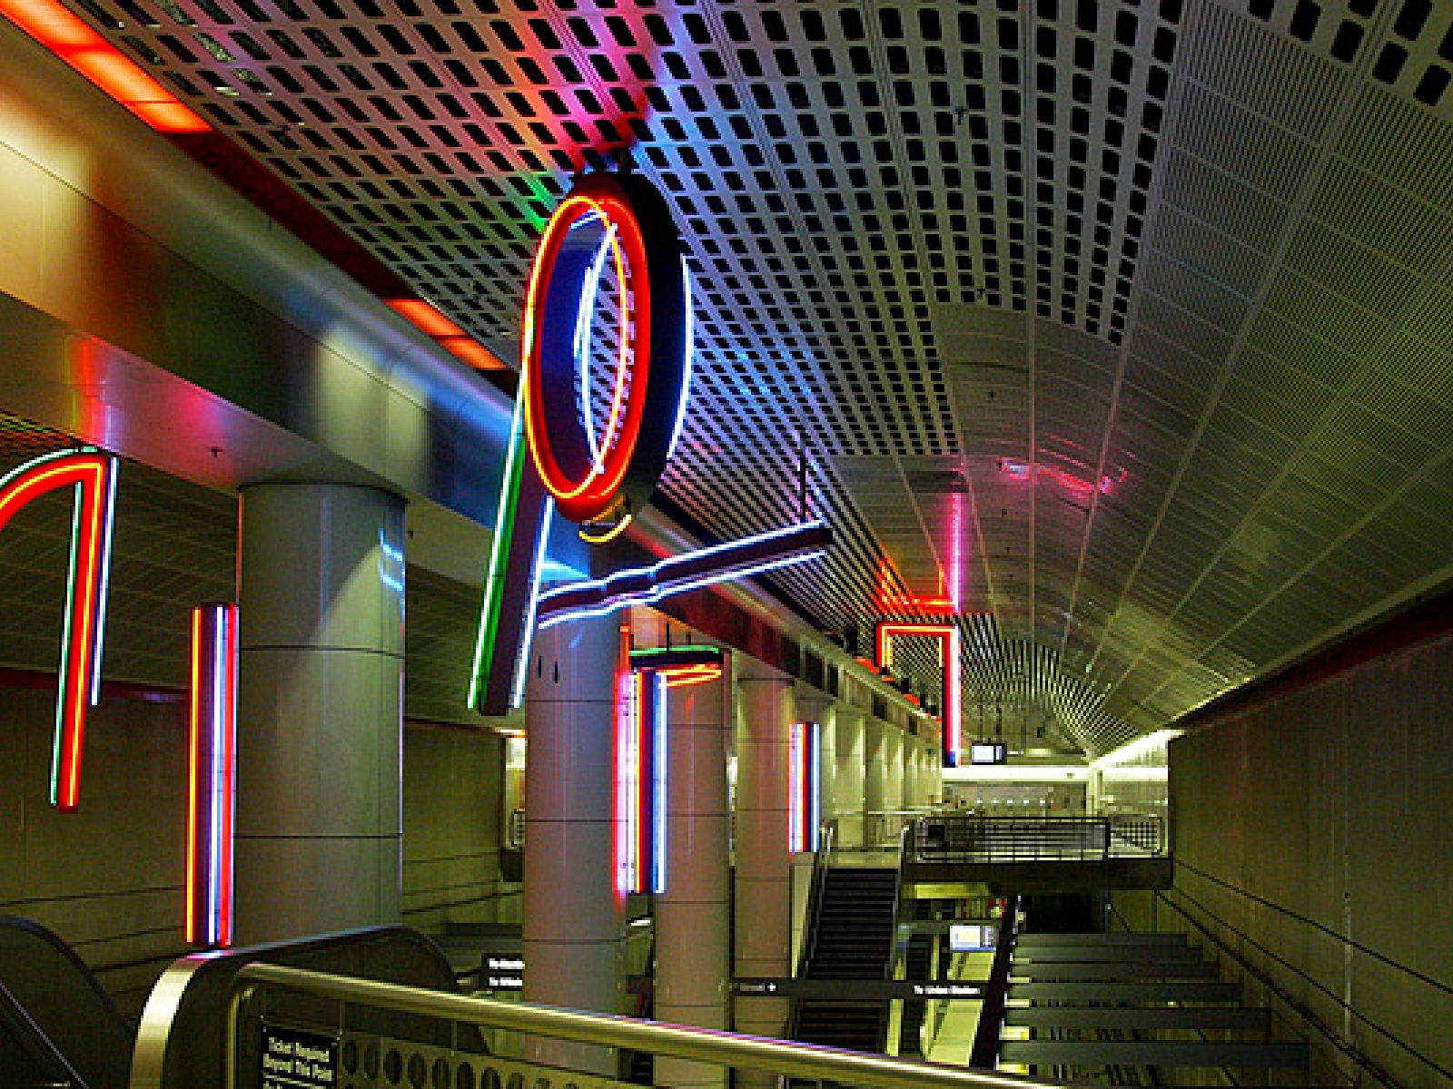
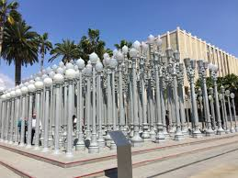
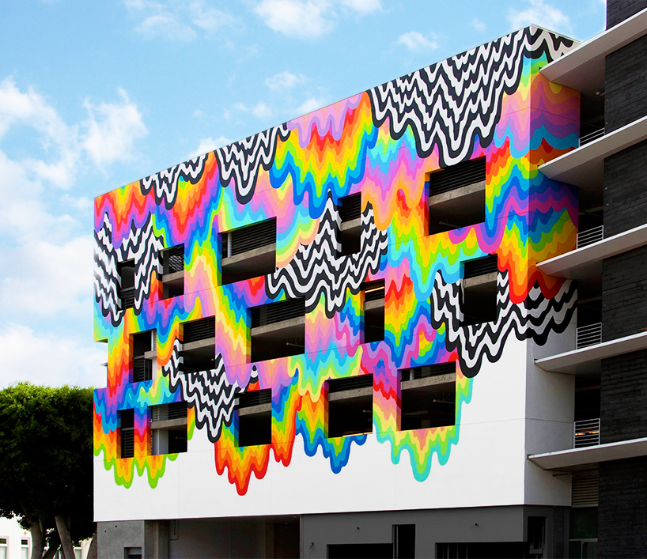
Murals are a type of public art
Public art: an umbrella term which includes any work of art purchased with public funds, or which comes into the public space regardless of where it is in the community, or who sees it.
Most public art is in urban centers like public squares, plazas or pedestrian areas. It is typically found anywhere that a lot of people pass through. Can also include schools, courthouses, libraries, airports and other government buildings.

Slide 3
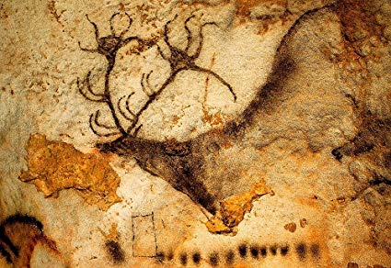
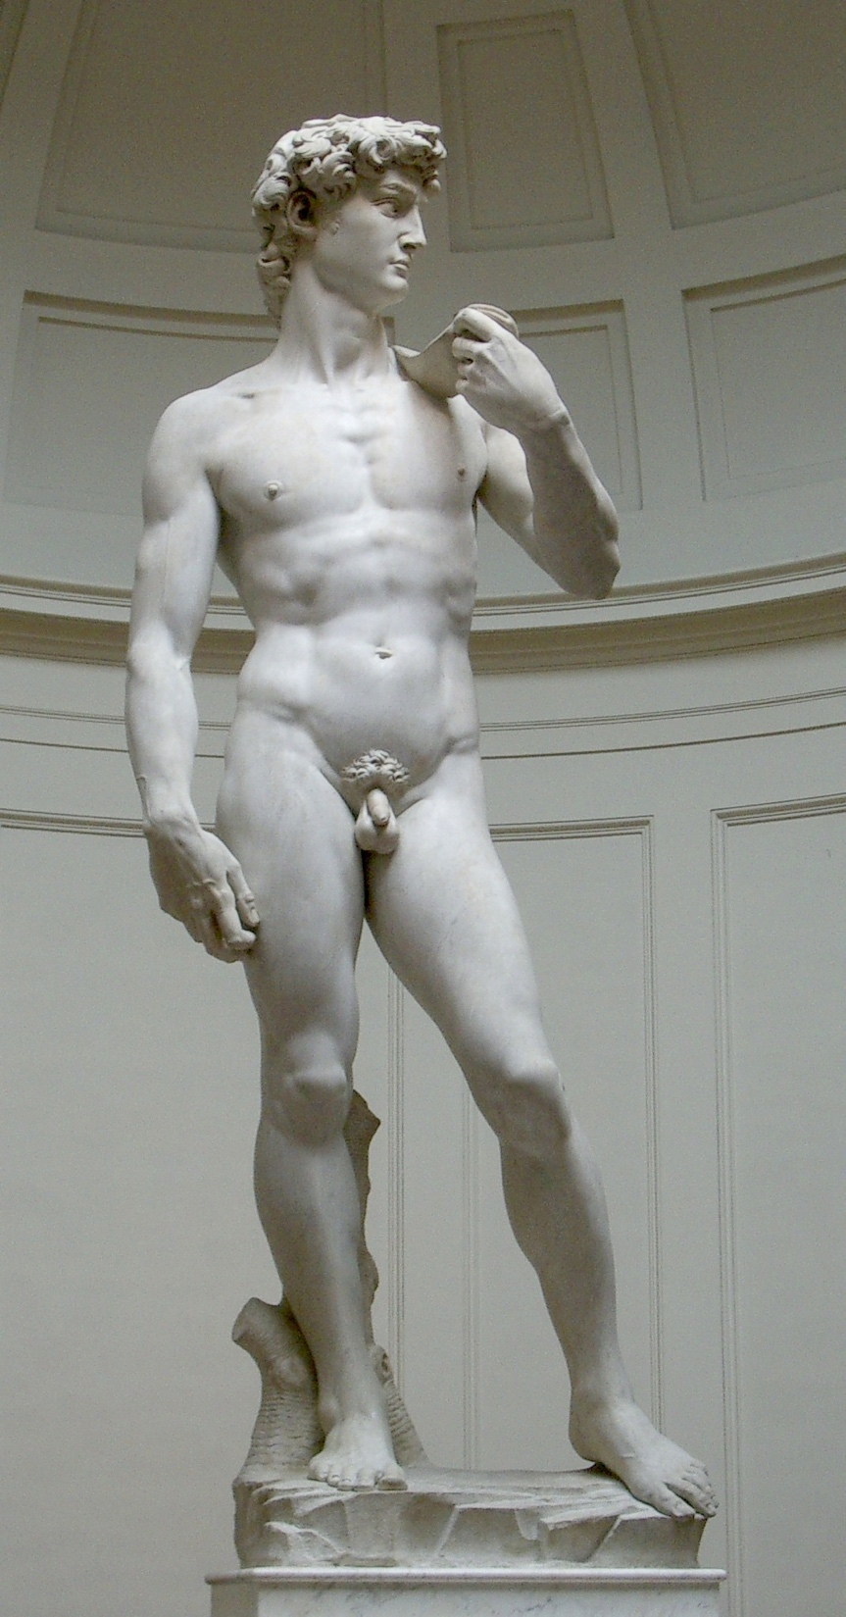
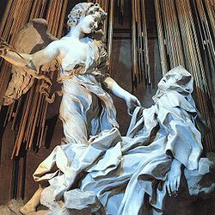
Earliest examples of Public art
Paleolithic Cave Paintings
Renaissance Period
Baroque Period
Notes:
During ancient Greece and the Baroque period public art was very common with mostly religious art. Even many of the famous works from the renaissance are considered public art.

Slide 4
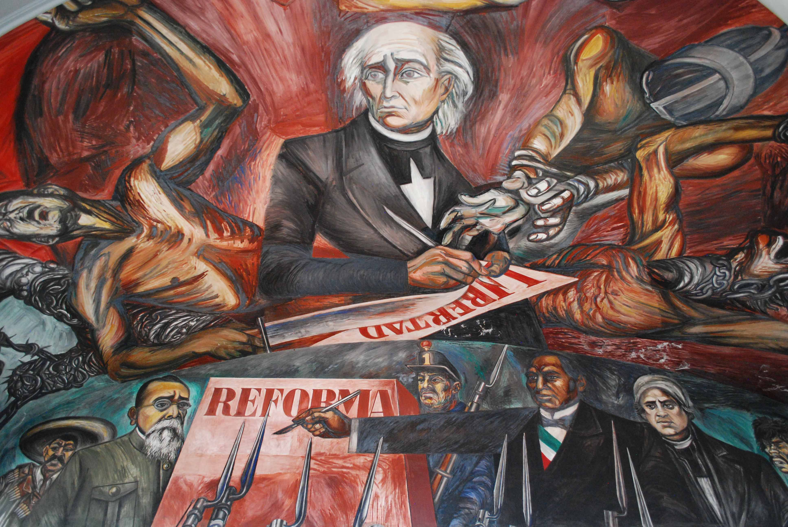
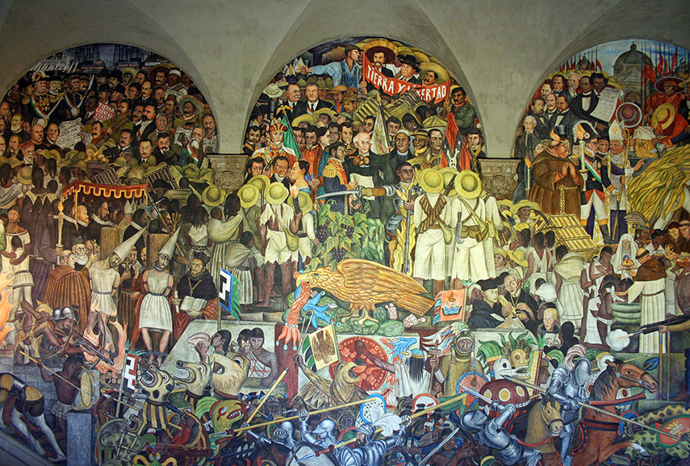
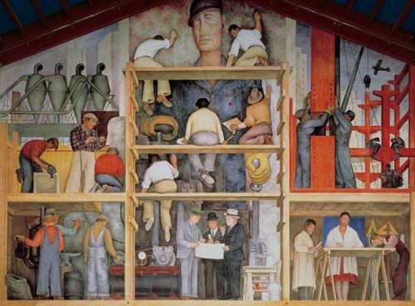
Mexican mural movement
1920’s – 30’s
Painters such as: Diego Rivera, José Clemente Orozco, David Alfaro Siqueiros
Paintings were mostly fresco, and depicted strong working people to be inspiring after the Mexican Revolution
Notes:
Painters like Diego Rivera helped start the Mexican mural movement, which we saw much more sophisticated murals for the first time. They were typically large scale outdoor fresco paintings with a political message

Slide 5
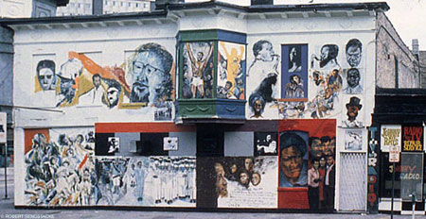
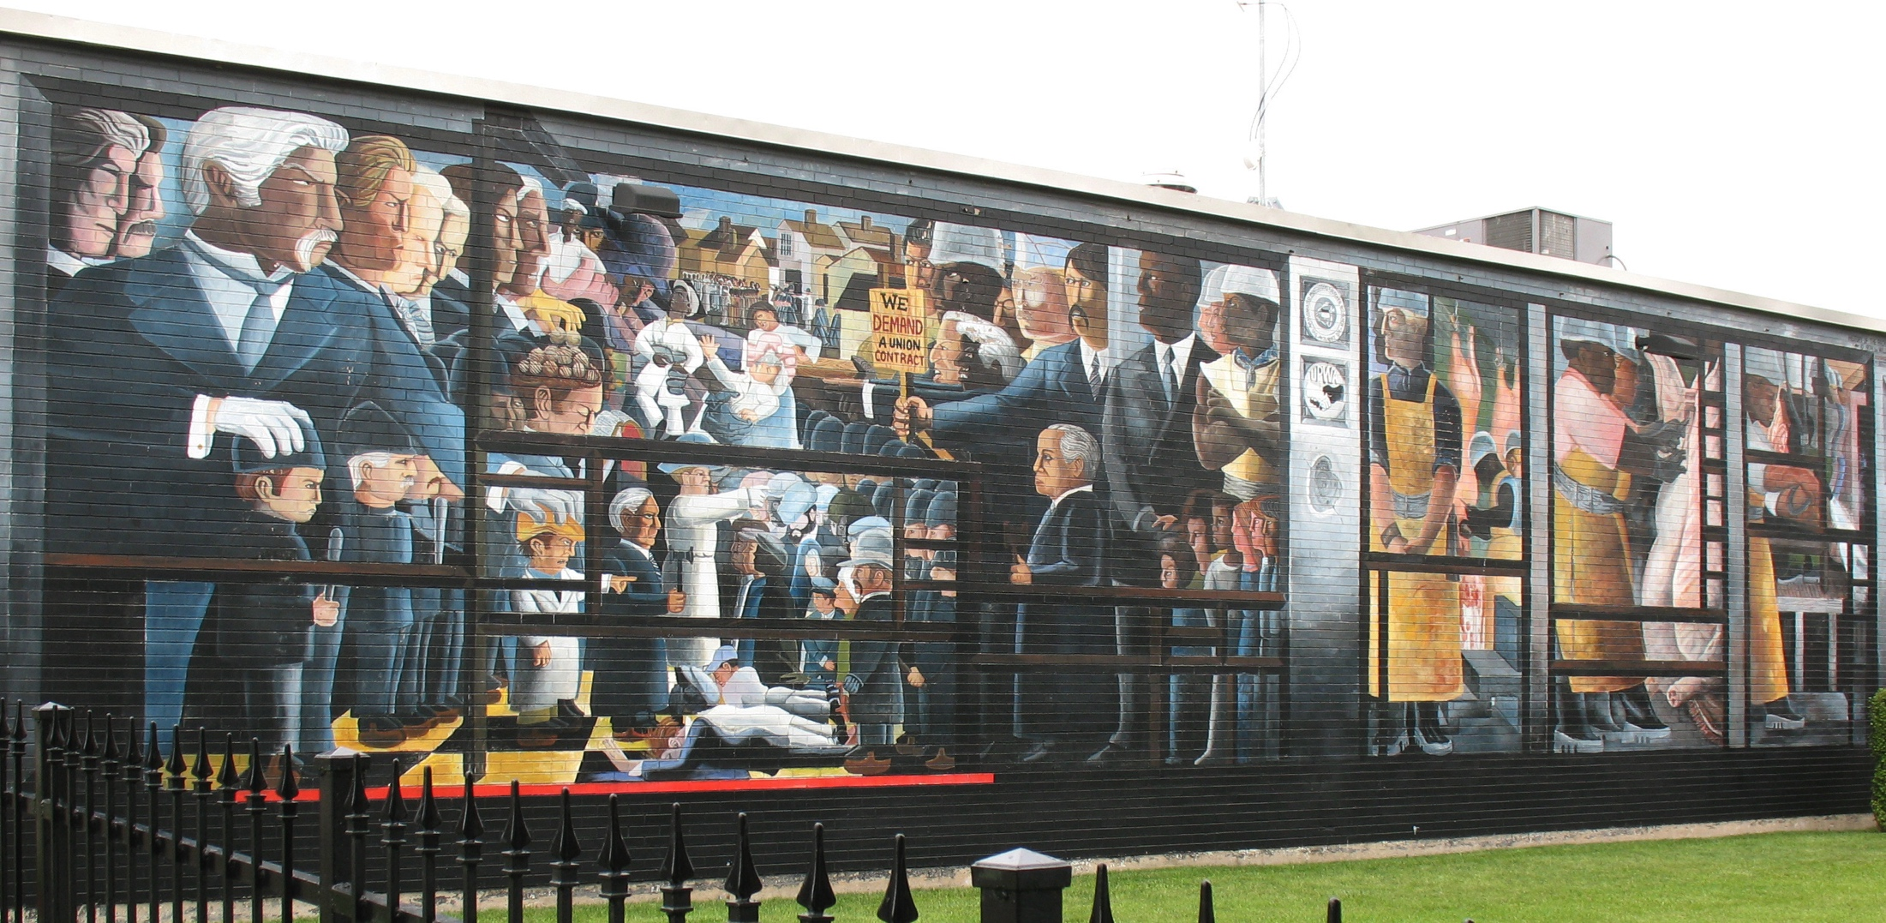
African American Mural Movement
1960’s-70’s
Started in Chicago with the “Wall of Respect”
Prominent Painter was William Walker
Notes:
In the 1960s came the African American mural movement which started in Chicago with a piece called the wall of respect. This was radical at the time due to its depiction of black figures and also the sense of community it brought to its viewers.

Slide 6
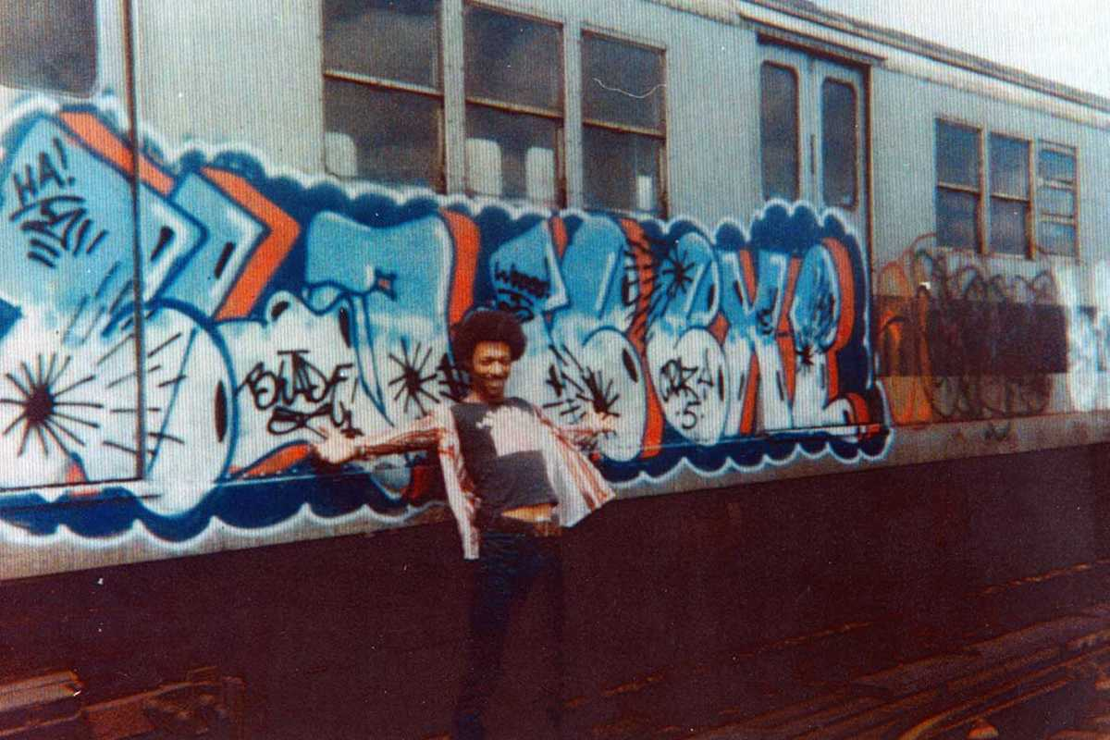
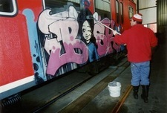
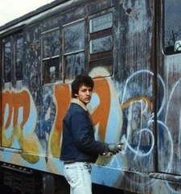
Modern graffiti movement
Sometimes called “style writing” or “aerosol art”
Began in the 70’s-now
Centered in New York City
Notes:
Shortly after in the 70s, the modern graffiti movement started which evolved concurrently with the mural/street art movement. Graffiti art was called “aerosol art” or “style writing”

Slide 7
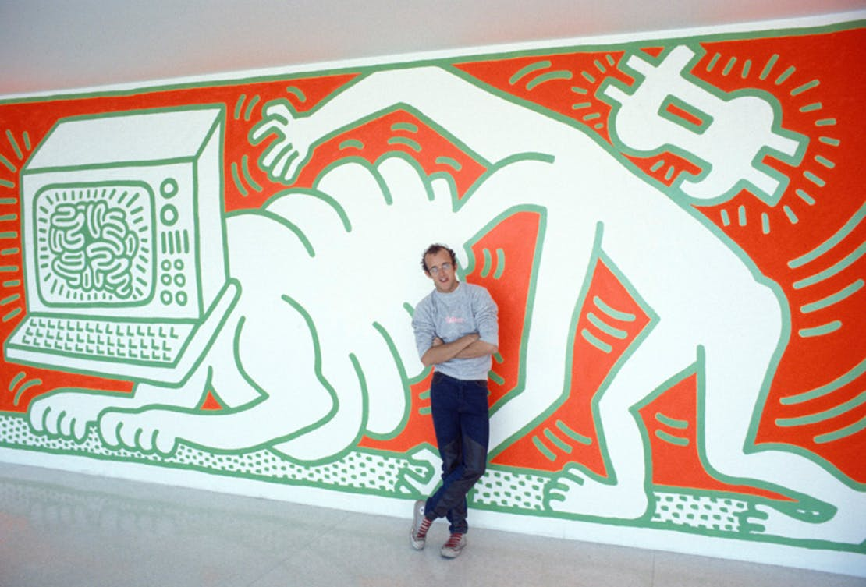
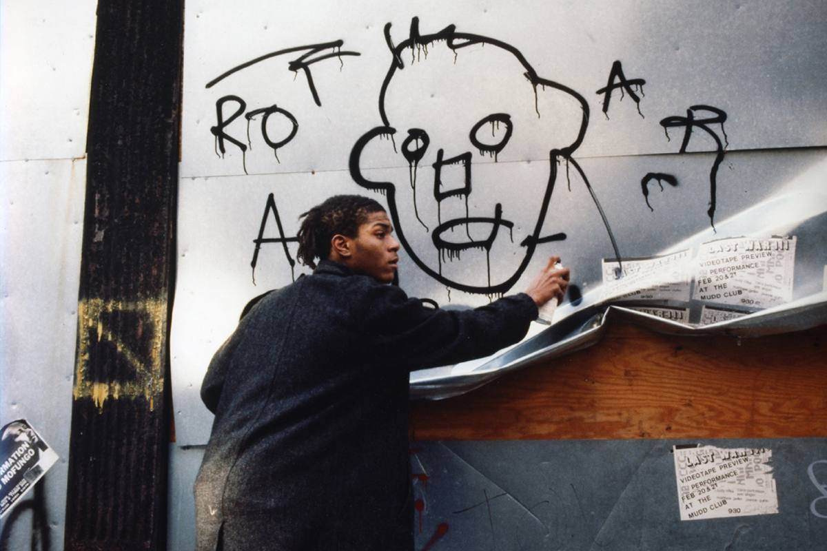
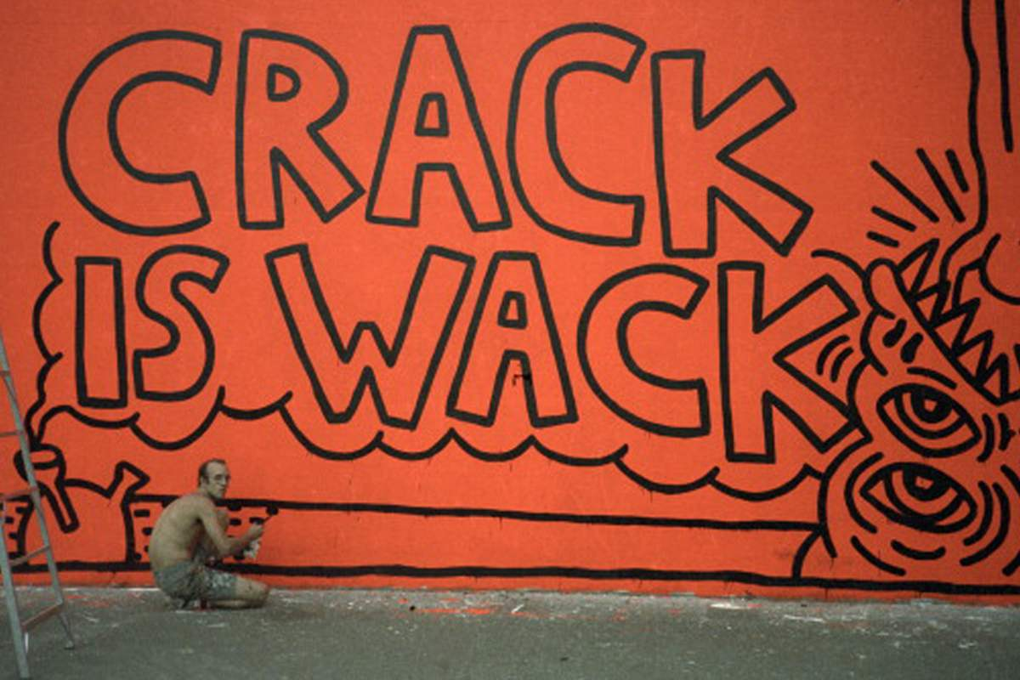
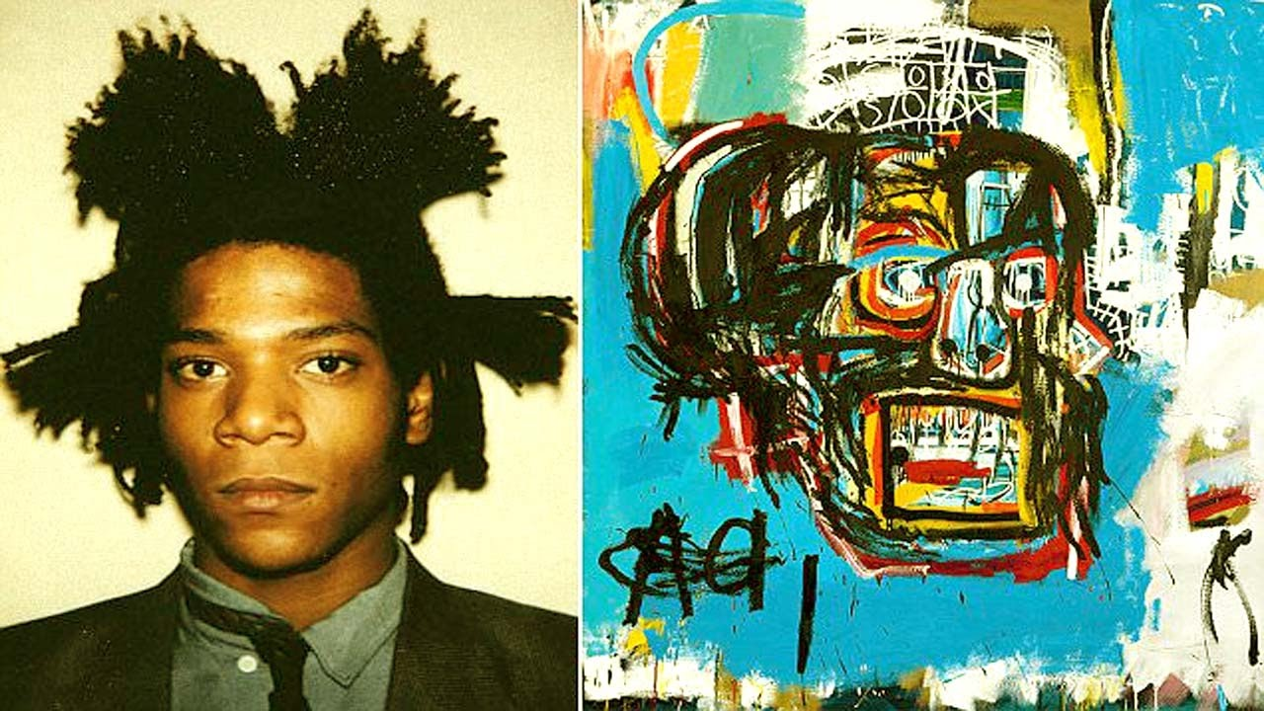
1980’s graffiti/street art
Jean-Michel Basquiat and Keith Haring really became noticed and created some of the most iconic pieces of contemporary art in NYC and had very successful commercial careers.
Notes:
by the 1980s public art had evolved to include more graffiti and started to mesh more with commercial art. Painters like jean-michel basquiat and Keith Haring really became noticed and created some of the most iconic pieces of contemporary art in NYC and had very successful commercial careers.

Slide 8
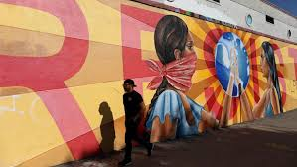
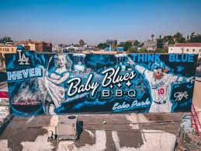
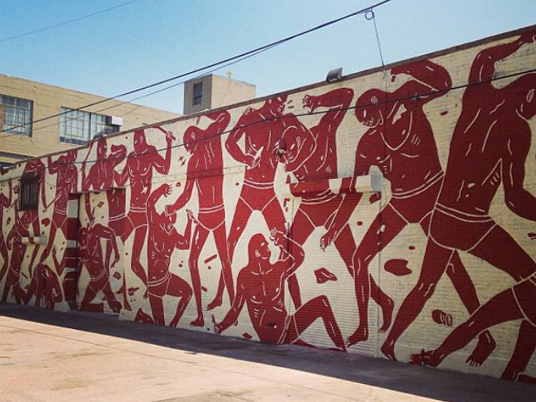
Street art today
mural/street artists continue the tradition set forth by continuing to make political art in the public space for all to see
Whether its to inspire or enrage or to fill a forgotten space with beauty, it starts conversations and makes art accessible for all people.
Notes:
In contemporary culture, mural/street artists continue the tradition set forth by continuing to make political art in the public space for all to see. Whether its to inspire or enrage, it fulfills a necessary space of starting conversation and creating art that is accessible for all people.

